Slide 1
Big Data is a Big Deal!

Slide 2
Our Team
SUSHANT AHUJA
Project Lead
Algorithm Design Lead
CASSIO CRISTOVAO
Technical Lead
Website Architect
SAMEEP MOHTA
Documentation Lead
Testing Lead

Slide 3
Contents
1. Project Overview
Project Background
Our Agenda
Project Purpose, Goals and Requirements
Project Support Environments
Project Technologies
2. Apache Hadoop and Spark
Apache Hadoop
Apache Spark
Difference between Hadoop and Spark
Cluster
Problems We faced
3. Our Schedule
Iteration 1
Benchmarks
Screenshots
Schedule
Project Risks and Measures
Iteration 2
Iteration 3 & 4
Our Accomplishments till date
Our Christmas Break Plans

Slide 4
Section 1: Project Overview

Slide 5
Project Background
Big Data Revolution
Phones, tablets, Laptops, Computers
Credit Cards
Transport Systems
Smart Data
Recommendation Systems
Netflix, Amazon, Facebook

Slide 6
Our Agenda (Problems we are solving)
Gathering Research data for validation
Performance tests in different environments
Predict data through recommendation systems
Improve the knowledge and awareness on Big Data at TCU Computer Science Department

Slide 7
Project Purpose
Test the performances of data mining algorithms in three environments:
Standalone Java
Apache Hadoop
Apache Spark
Mine different sizes of data
Turning ‘Big Data’ into ‘Smart Data’
Build recommendation system

Slide 8
Project Goals
Compare efficiency of 3 different environments
Validate the Feasibility
Transform structured query process into non-structured Map/Reduce tasks
Report performance statistics (3 environments)
Single Node
Cluster
Test Master-Slave structure reliability

Slide 9
Project Requirements
Provide all information and guidelines to set up:
Hadoop Map/Reduce (Single & Cluster)
Spark (Single & Cluster)
Generate a comparable output file for each test
Build recommendation systems based on the experience our team acquired

Slide 10
Project Support Environment
Six Linux machines, each running Ubuntu 15.04
Cluster:
One master node for Hadoop and Spark each
Two slave nodes for Hadoop and Spark each
Eclipse IDE

Slide 11
Project Technologies
Java Virtual Machine
Apache Hadoop
Apache Spark
Maven in Eclipse for Hadoop and Spark
Mahout on Hadoop systems
MLlib on Spark systems

Slide 12
Section 2: Apache Hadoop and Spark

Slide 13
Apache Hadoop
Born out of the need to process an avalanche of data
Open-source software framework
Was designed with a simple write-once storage infrastructure
MapReduce – relatively new style of data processing, created by Google
Become the go-to framework for large-scale, data-intensive deployments

Slide 14
Apache Hadoop
Can handle all 4 dimensions of Big Data – Volume, Velocity, Variety, and Veracity
Hadoop’s Beauty – efficiently process huge datasets in parallel
Both Structured (converted) and Unstructured
HDFS – breaks up input data, stores it on compute nodes (parallel processing)

Slide 15
HDFS Segmentation

Slide 16
Hadoop Map/Reduce
Map Phase:
Splits input data-set into independent chunks
Processed in parallel manner – map tasks
Framework sorts the output of map tasks
Reduce Phase:
Takes input from map function
Performs summary operation
Output stored in HDFS

Slide 17
Hadoop Map/Reduce

Slide 18
Apache Spark
Open source big data processing framework designed to be fast and general-purpose
Fast and meant to be ease to use
Originally developed at UC Berkeley in 2009
Notes:
1-
2-
3-
4-

Slide 19
Apache Spark
Supports Map and Reduce functions
Lazy evaluation
In-memory storage and computing
Offers APIs in Scala, Java, Python, R, SQL
Built-in libraries; Spark SQL, Spark Streaming, MLlib, GraphX

Slide 20
Apache Spark

Slide 21
Difference Between Hadoop and Spark
Not mutually exclusive
Spark – does not have its own distributed system, can use HDFS or others
Spark – Faster as works “in memory”, Hadoop works in Hard drive
Hadoop – needs a third-party machine-learning library (Apache Mahout), Spark has its own (MLlib)
Not really a competition as both are non-commercial, open-source

Slide 22
Hadoop Cluster
One master node with two slave nodes, all with same configuration
Namenode on master, datanodes on slaves
Still trying to make it work…

Slide 23
Problems we faced
Developing use-case models
Setting up a cluster

Slide 24
Section 3: Our Schedule

Slide 25
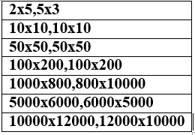
Iteration 1
Setting up 6 Linux machines
Hadoop and Spark on 2 machines as master nodes
2 slave nodes for Hadoop and Spark each
Initial Software Tests
Word Frequency Count on all the 3 environments with text files of different sizes (10mb, 50mb, 100mb, 500mb, 1gb, 5gb and 10gb)
Large Matrix Multiplication
with the following matrix sizes:

Slide 26
Benchmarks

Slide 27
Word Count
 | Text File Size | JAVA | Hadoop | Spark
1 | 10 Mb | 1.167 | 0.21654 | 0.144
2 | 50 Mb | 6.628 | 0.2898 | 0.4096
3 | 100 Mb | 11.769 | 0.39986 | 0.436
4 | 500 Mb | X | 1.34254 | 4.894
5 | 1 Gb | X | 2.87 | 9.478
6 | 5 Gb | X | 19.19006 | 47.388
7 | 10 Gb | X | 41.1566 | 96.578
All Times in minutes

Slide 28
Matrix Multiplication
 | Matrix Sizes | JAVA | Hadoop | Spark
1 | 2x5,5x3 | 0.0000167 | 0.2 | 0.156
2 | 10x10,10x10 | 0.0004 | 0.18654 | 0.158
3 | 50x50,50x50 | 0.00075 | 0.18306 | 0.158
4 | 100x200,100x200 | 0.00295 | 0.2 | 0.168
5 | 1000x800,800x10000 | 20.55 | 6.56874 | 0.314
6 | 5000x6000,6000x5000 | 66 | X | 1.226
7 | 10000x12000,12000x10000 | X | X | X
All Times in minutes

Slide 29
Screenshots

Slide 30
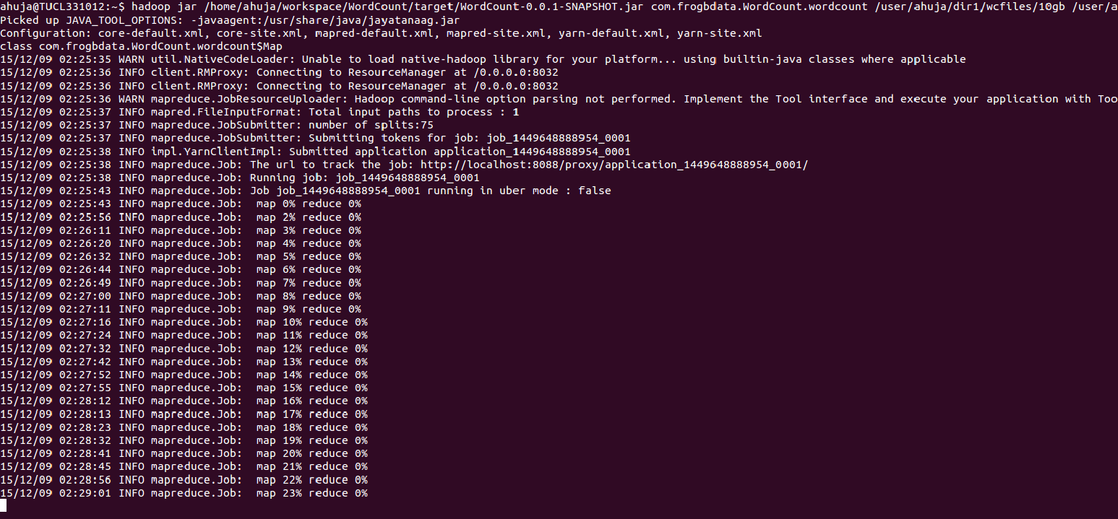
Hadoop

Slide 31
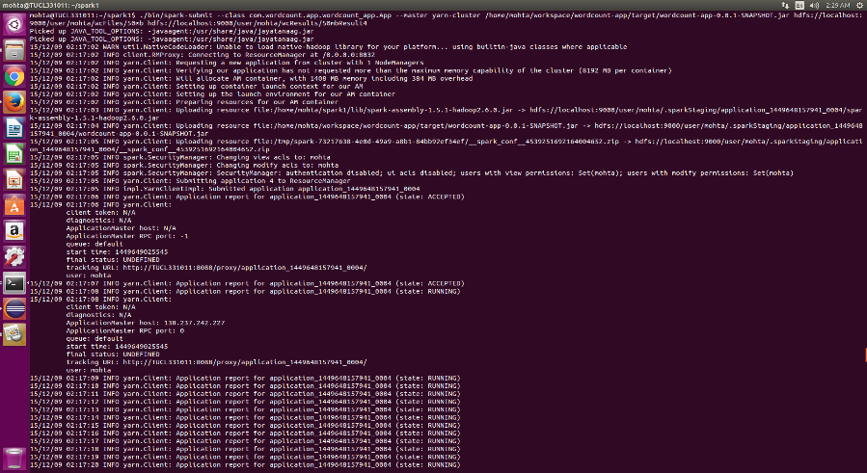
Spark

Slide 32
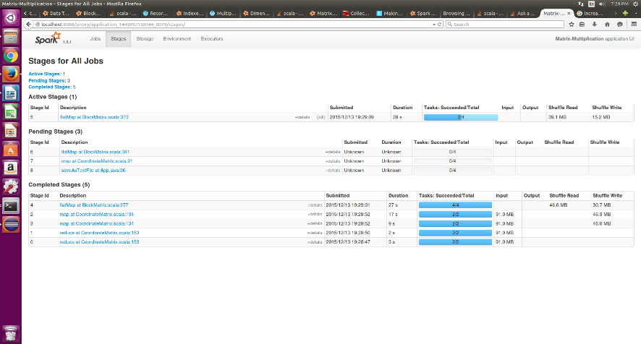
Spark

Slide 33
Project Risks and Measures
Contingency | Probability | Severity | Mitigation Strategy
Project Not finished | Low | Catastrophic | Work efficiently In a timely manner
System Failure | Low | Critical | Have backup machines
Data Loss | Moderate | Moderate | Backup of Data properly
Group Member unavailable at critical time | Moderate | Moderate | Make sure every team member knows what they are doing
Root Access not available at critical times | Moderate | Moderate | Be prepared and plan in advance

Slide 34
Schedule
Skeleton Website 4 October, 2015
Project Plan v1.1 25 October, 2015
Requirements Document v1.2 17 November, 2015
Software Engineering Presentation 15 December, 2015
Design Document v1.0 15 December, 2015
Iteration 1 15 December, 2015
Iteration 2 21 January, 2016
Iteration 3 3 March, 2016
Iteration 4 31 March, 2016
User manual 5 April, 2016
Developer manual 7 April, 2016
SRS 8 April, 2016
NTASC Presentation 16 April, 2016
Complete Documentation 26 April, 2016
Final Presentation 28 April, 2016

Slide 35
Iteration 2
Setting up a cluster with at least 2 slave nodes.
Running Mahout on Hadoop systems and Mlib on spark systems
Perform unstructured text processing search on all 3 machines
Perform classification on both the clusters

Slide 36
Iteration 3 & 4
Iteration 3:
Using K-means clustering on all 3 machines
Iteration 4:
Using K-means clustering to create recommendation systems from large datasets on all 3 machines

Slide 37
Our Accomplishments till date
Iteration 1
40% Iteration 2

Slide 38
Our Christmas Break Plans
Making the cluster work!
Run all the tests in the cluster
Unstructured text processing search on the cluster
Plan and gather data for our recommendation system

